Slide 1

WELCOME!
WE ALL CAN BE A UNITED WAY CHAMPION!
Thousands of our neighbors depend on the workplace campaign to help raise funds for local nonprofits.

Slide 2
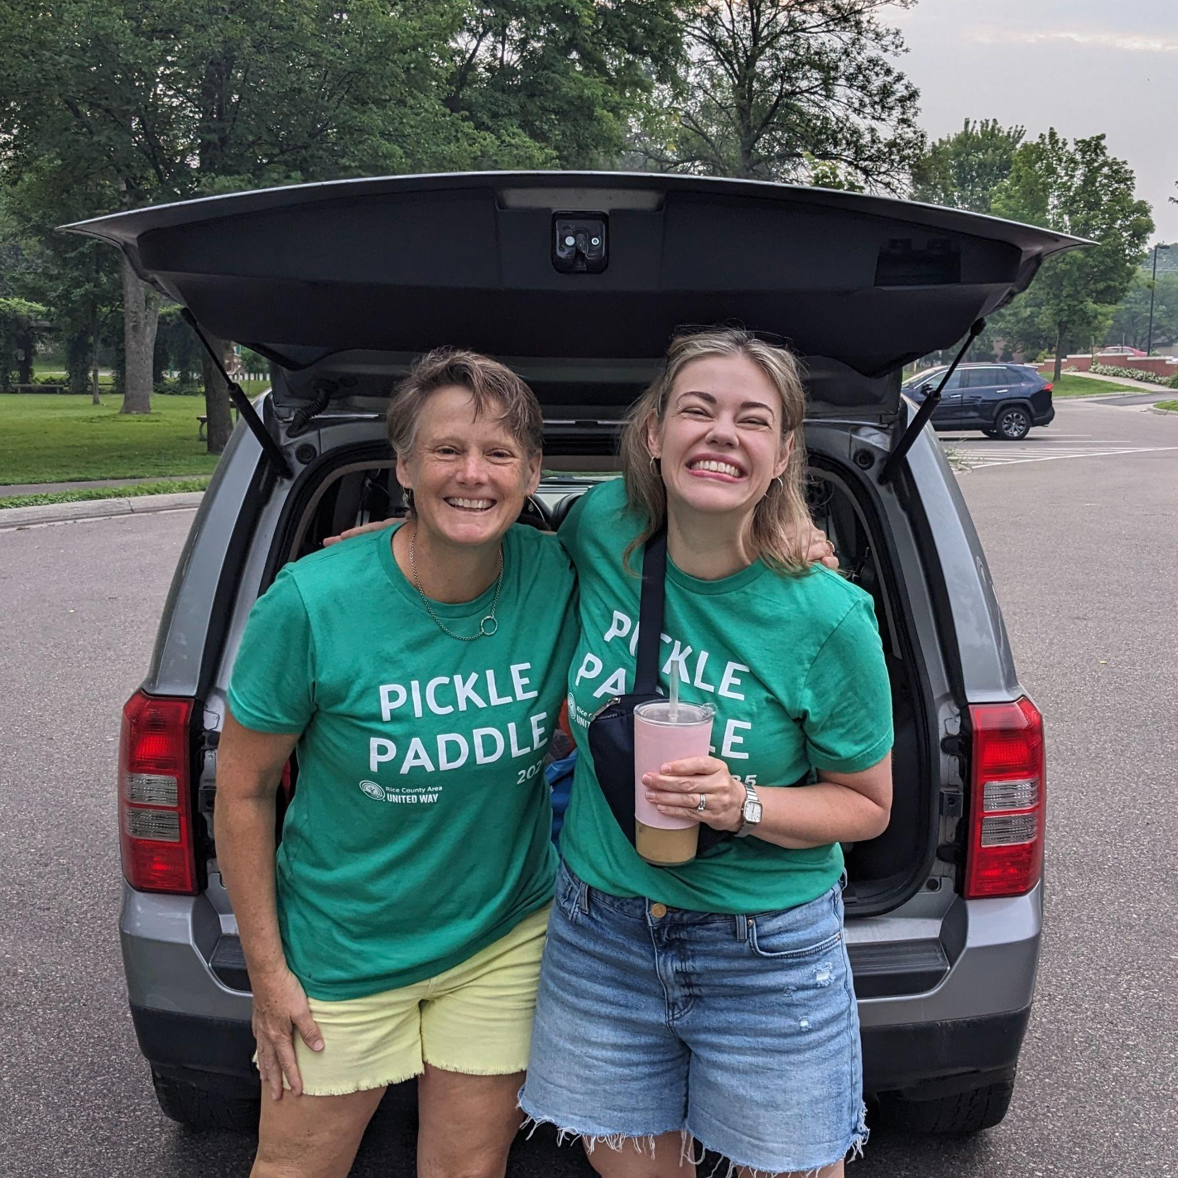
WHO WE ARE

Slide 3

WHY UNITED WAY?
All dollars stay LOCAL and support our neighbors right here in Rice County
Giving to United Way is EASY and SIMPLE–at many workplaces you may set up donations to come directly out of your payroll!

Slide 4

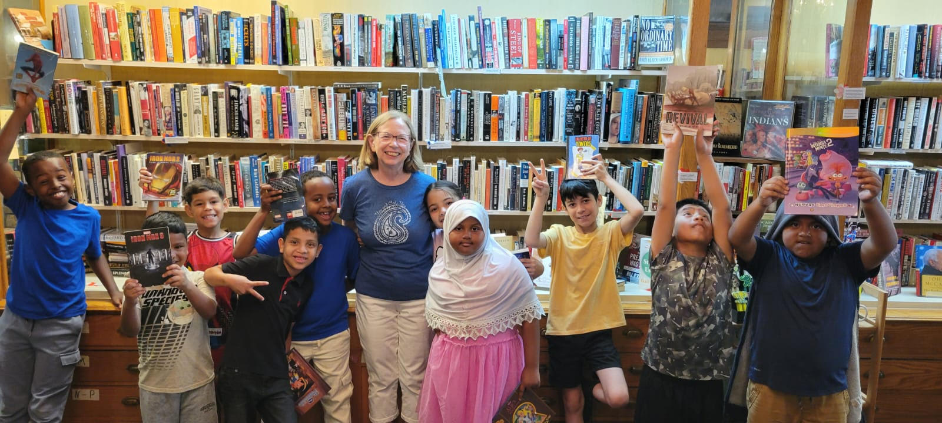


Notes:
How to Use Master Slides
Master Slides allow presentations to remain consistent and uniform, making sure that styles, footers, and headers remain consistent.
This template includes many different slide layout options. These can be accessed by clicking the dropdown arrow under New Slide, or you can change your current slide’s layout by selecting the Layout dropdown menu in the Home tab of the ribbon.
Any elements with a dotted line around them (images, text, etc.) are placeholder content. If they are not filled in, they will not show up when presenting or exporting the PowerPoint. If you are using a layout and do not want to use a placeholder element, simply delete it.
To replace an image with a file saved on your computer, simply click the icon and it will pull up a file navigation window. You can also drag images into the placeholders. To use images from Brandfolder, see the Brandfolder Integration section below or reference the Templates section of the Brandfolder FAQs document for more information.
Global Changes (Changing the Presentation Title/Logo)
You should not need to make any global changes other than the “PRESENTATION TITLE OF A FEW WORDS” at the top of the slides and the United Way logo on the bottom left if you are a United Way member organization. In order to make any global changes (changes that affect every slide based on its master slide template) you will need to go to View > Slide Master. To exit, select View > Normal, or X out of Slide Master on the Slide Master tab.
To change the presentation title, simply type in your title on the two parent slides in the Slide Master view (the top-level slides). This should populate all the slides; the only exception would be the “Images Full Splash” layout, which will need to be updated manually on the actual slide if used).
Example Slides in This Template
There are a few instances in this template where the content is not “placeholder content” and is instead an example of how to format specific indicators (numbers, statistics, quotes, etc.).
The charts are not placeholder content but are formatted correctly, such that you should just be able to edit the Excel data to update them.
Copy and Paste Match Style
It is very important to maintain visual consistency within and across presentations and to ensure that various styles don’t end up all mixed together in one presentation.
When copying a slide from another presentation:
Once the slide is pasted into the deck, select the clipboard icon that appears on the thumbnail in the sidebar and make sure “Use Destination Theme” is checked. While the fonts may have to be manually changed, this will at least ensure that the slide is using the same slide masters and color palettes as the rest of the presentation.
When copying text into a placeholder/existing textbox:
Brandfolder Integration
Brandfolder can be added as a plugin to PowerPoint using the following steps:
Visit this page to download the plugin: https://appsource.microsoft.com/en-us/product/office/WA104381702?src=office&corrid=beb471e9-d0e2-0d3b-f5e9-37f98d6f2c8b&omexanonuid=&referralurl=&ClientSessionId=680d0963-b4cb-4386-9723-62004e83b69b
Sign in with your Microsoft 365 account
Open the plugin in Word/PowerPoint
Input the API key. You can find the API key in your Brandfolder profile under the Integrations tab, or at this link: https://brandfolder.com/profile#integrations
You’re done! To use the plugin when opening Word/PowerPoint, Click Insert > Add-ins > My Add-ins, select Brandfolder and click Add. To reference the plugin after setup, open the Insert tab and it should live in that ribbon. Learn more about the basics of this integration and how to use it at this link: https://help.smartsheet.com/articles/2482997-Microsoft-Office-Integrations-
Using Brandfolder images in placeholder content spots:
Click through the Brandfolder plugin until you find your desired image.
Editing Online
Selecting the image and clicking Place should drop the image into the placeholder and maintain the shape of the placeholder container.
Editing on Desktop
Brandfolder gets a bit tricky when trying to add placeholder content on the desktop and doesn’t like to drop the images directly into the containers when placing them.
For rectangular shapes: place the image, copy the image, click on the placeholder container (not the icon) and paste. The image should be in the container.
For odd shapes like circles or arcs, it works best to download the file and click the icon to find it and place it, or to edit online.
If you don’t like how the image has been placed, simply right click, select Crop and move the image around until you are happy with its placement. It should retain the container’s shape.
Choosing Brand Colors
The color palette for this template reflects the United Way color palette. Please reference our color swatches in the Theme Colors (very top row of the Microsoft color palette grid).
Most of the colors that are used should be pulled from the three primary colors (blue, red, yellow) and should be the top-level color provided, though the varying shades can be used as additional elements to provide dimension.
Blue is the primary color used for texts and accents. Secondary and tertiary colors should be used as accents and for data visualization but should not be used without any of the primary colors present.
Contrast is key for accessibility – see page 20 in the Brand Guidelines PDF for a set of approved color combinations. You can also use an online tool, such as the Adobe Color Contrast Analyzer (https://color.adobe.com/create/color-contrast-analyzer), to check contrast ratios.
For more information regarding usage of color within the United Way brand identity, please reference the Brand Guidelines.

Slide 5

OUR GOAL
This year we’re asking you to help us raise $400,000!

Slide 6
IMPACT

Slide 7

Last year, we served over 37,000 people in Rice County

Slide 8
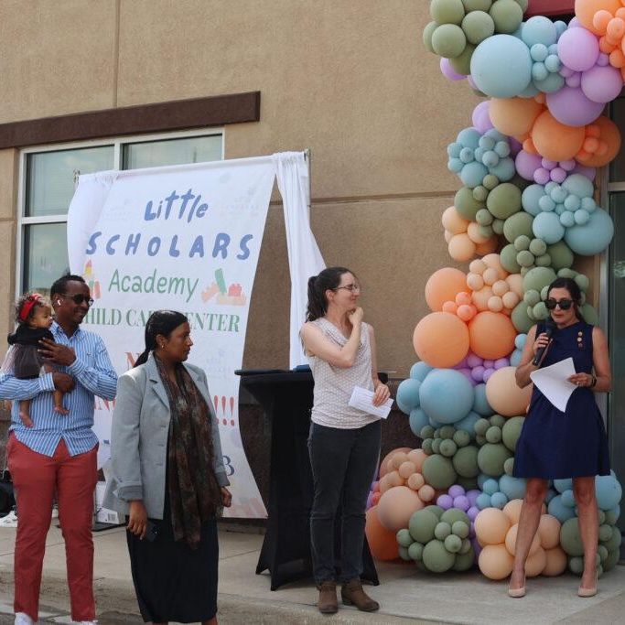
IMPACT STORIES
Healthy Community Initiative
Healthy Community Initiative (HCI) helped make possible the grand opening of a second location of Little Scholars Academy in Faribault. The center will serve up to 77 children, providing families with safe, high-quality childcare and strengthening the local workforce.

Slide 9
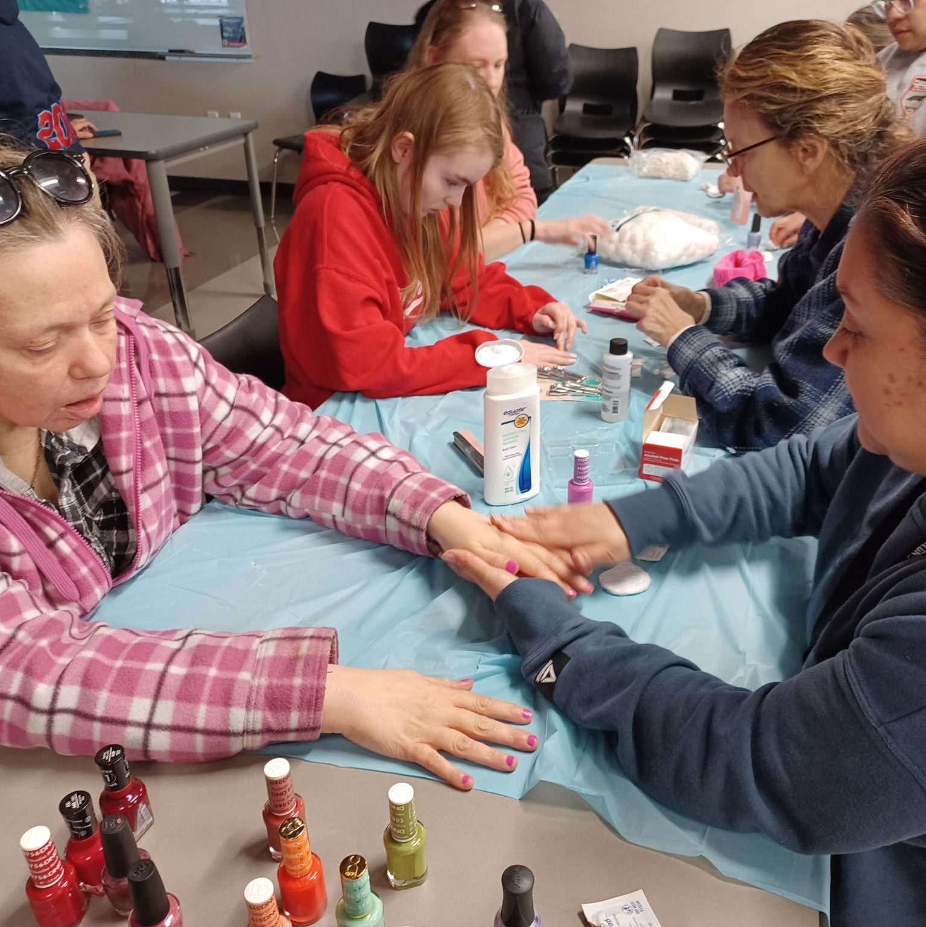
IMPACT STORIES
Project ABLE
Project ABLE gives adults with disabilities opportunities to learn, grow, and build friendships. Events like Pizza Bingo, community dinners, dances, and social outings offer participants vital connection, joy, and belonging.
With United Way’s support, registrations more than doubled, rising from 1,046 to 2,773.

Slide 10
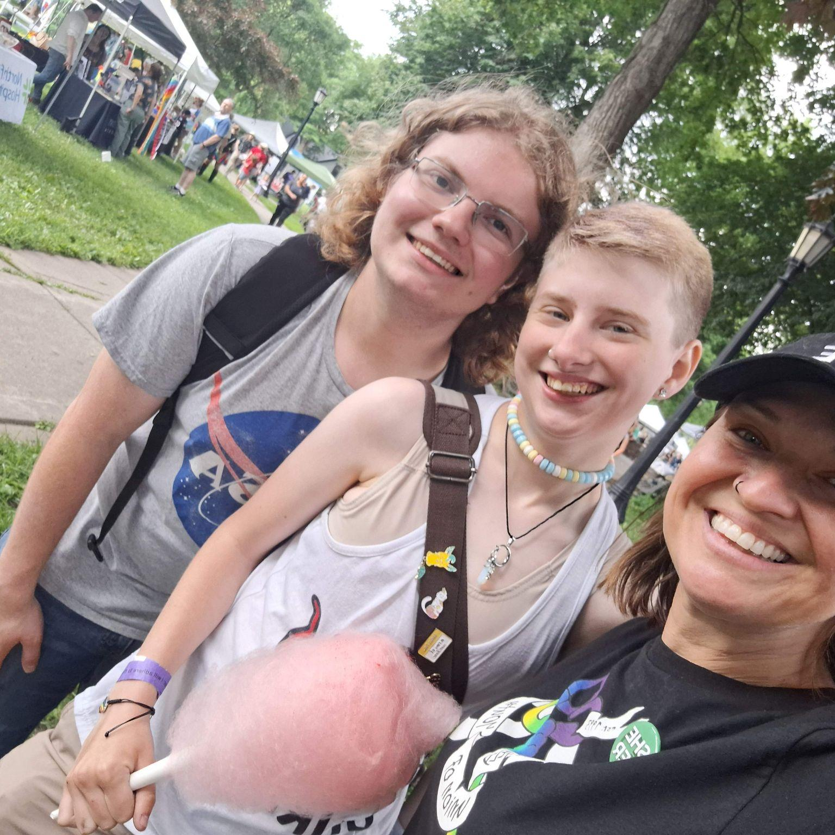
IMPACT STORIES
The Key - Union of Youth
The Key - Northfield Union of Youth is more than a drop-in space—it provides stability, connection, and hope. This past year, The Key’s Wallflower Project supported youth experiencing homelessness. Beyond housing, The Key’s weekly meals, bonfires, and events like the Hot Wing Challenge offer young people safe opportunities to relax, build friendships, and gain the confidence to take the next step toward a stronger future.

Slide 11
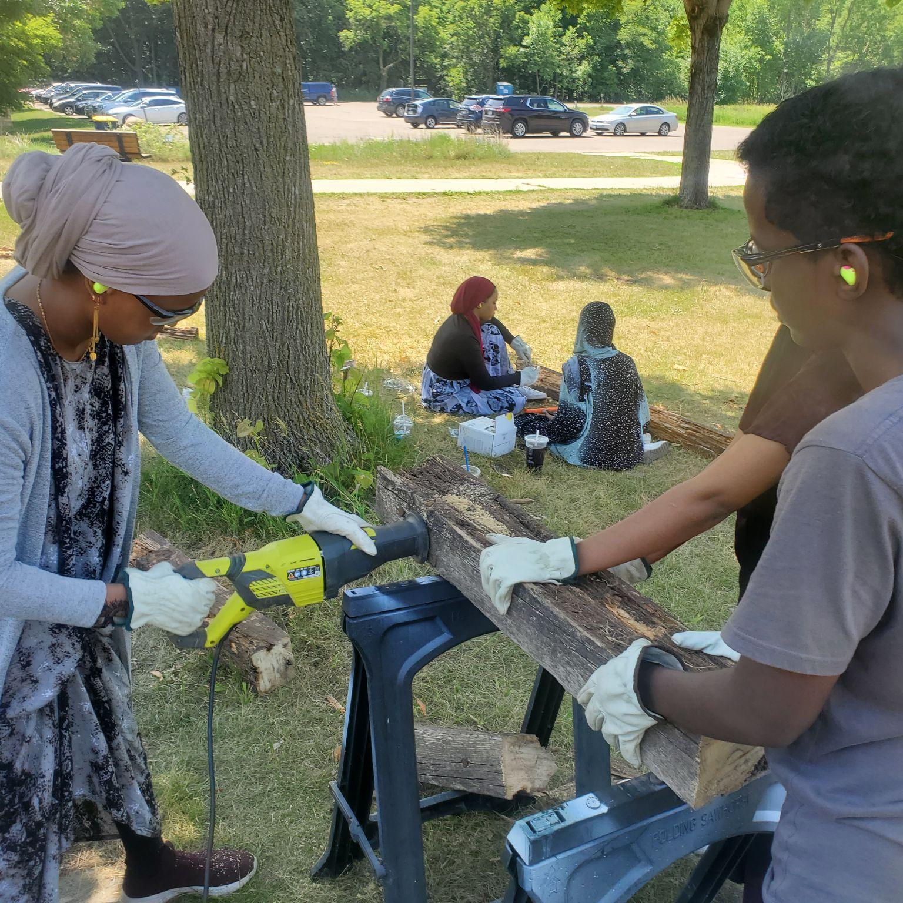
IMPACT STORIES
River Bend Nature Center
This year River Bend launched its Outdoor Diversity Initiative, a series of programs focused on workforce development and building career pathways for low income communities to access gainful careers in natural resource management.
They also provided 5,545 kids with interactive nature programing.

Slide 12

IMPACT STORIES
Dolly Parton’s Imagination Library
Thanks to our incredible community, this year’s Dolly Parton Book Bash raised over $58,000, funding books for 1,700 children! Your donation helps us get books into the hands of more children.
Save the date now for the 2026 Dolly Parton Book Bash, which will take place on January 30 at the Faribault American Legion.

Slide 13
Ways to Give

Slide 14
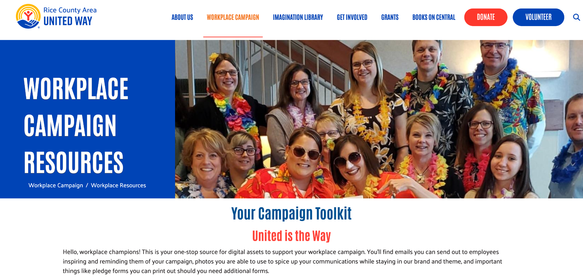
Notes:
https://www.ricecountyunitedway.org/workplace-campaign-resources

Slide 15
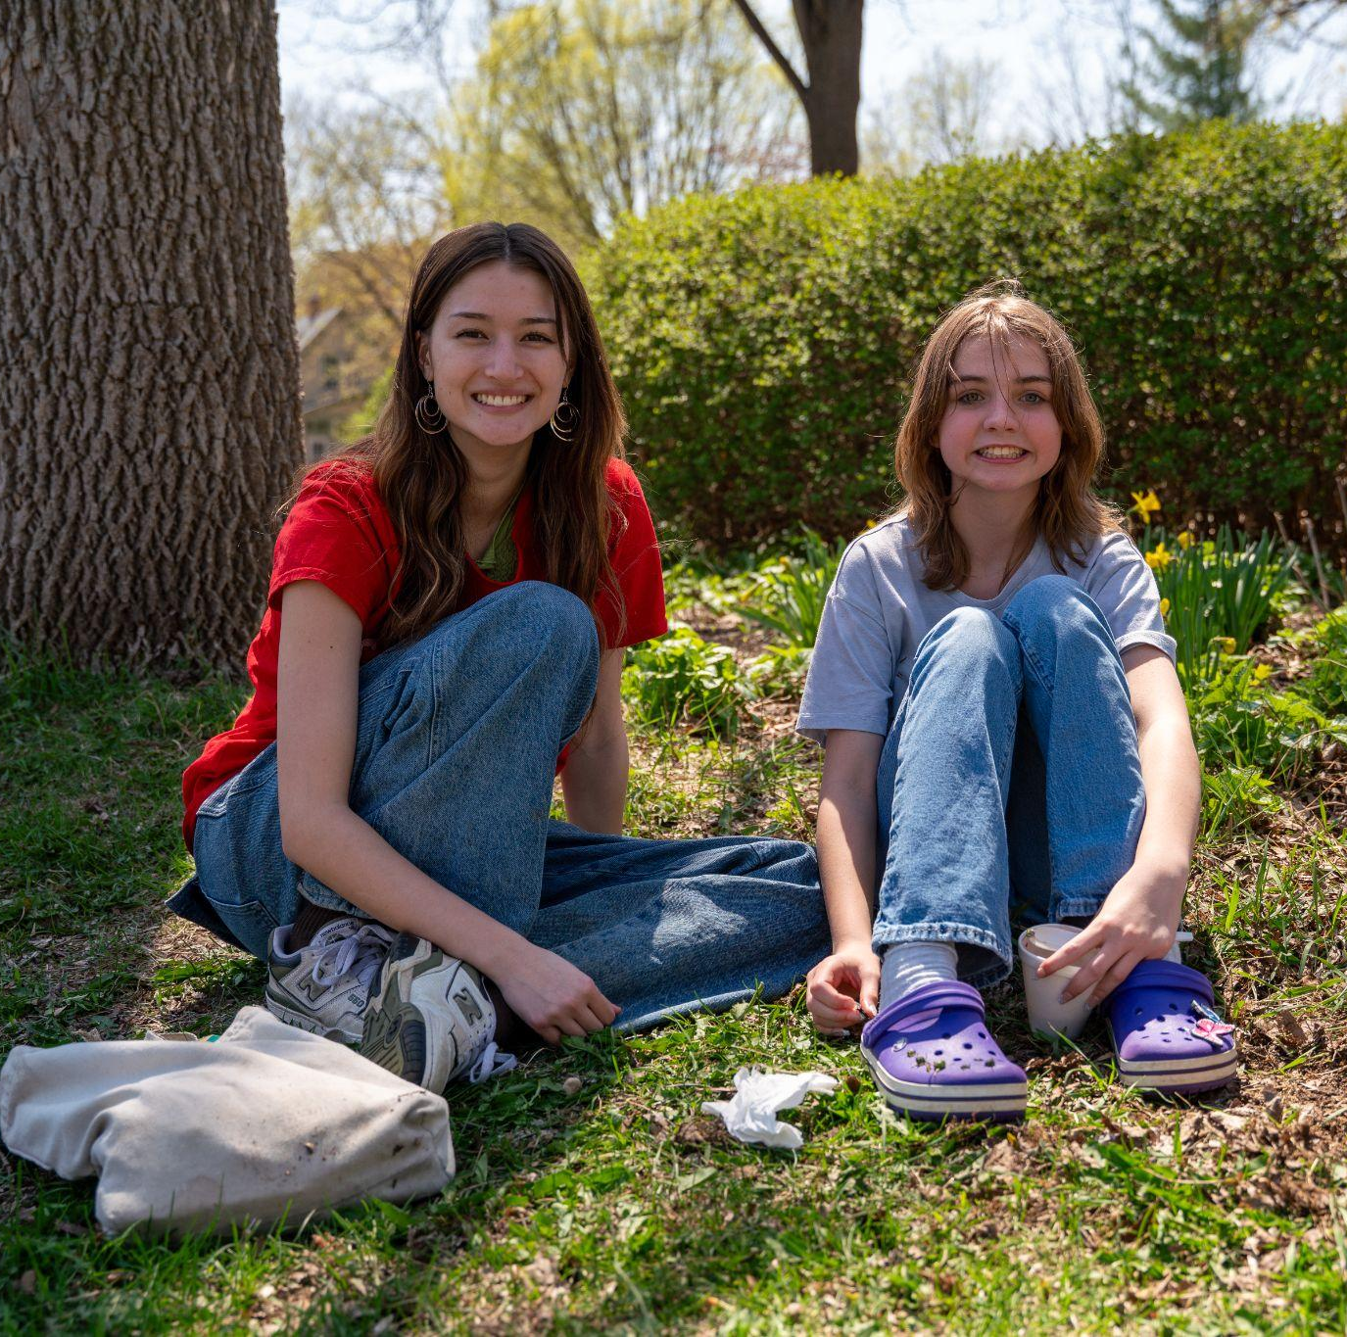
EACH WORKPLACE IS UNIQUE
Depending on your workplace you may use
Payroll deduction
Paper pledge form
Online pledge form/United Way website

Slide 16

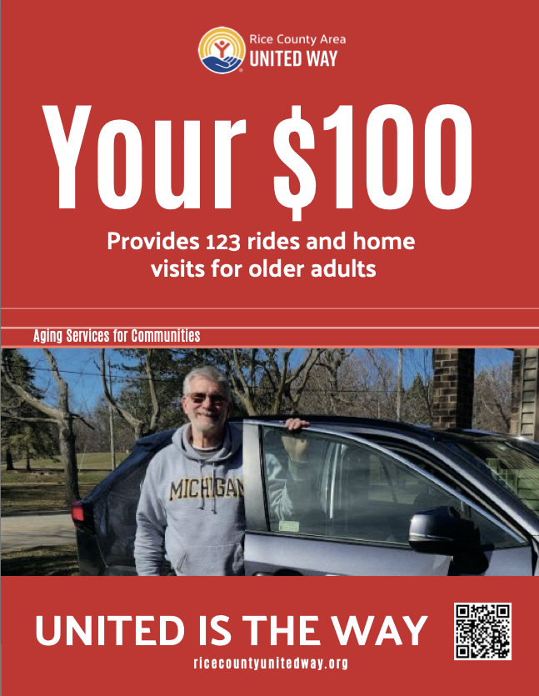
CAMPAIGN RESOURCES

Slide 17
EVERY AMOUNT MATTERS
If you’ve never given before, we’d love to have you join us
Your donation goes to the areas of greatest need and has real impact
When we each contribute what we can we create a network of combined giving that creates positive change
Every amount matters!

Slide 18
THANK YOU!
www.ricecountyunitedway.org/donate PLEASE JOIN US. UNITED IS THE WAY WE THRIVE!

